Slide 1

Task 3
Market Price
PREDICTION
Ibrahim Tarek Abdelazeem

Slide 2

Table of
CONTENTS
01
02
03
04
Data Preprocessing
Exploratory Data Analysis
Feature Engineering
Model Selection and Training
05
06
07
ARIMA/SARIMA Model
LSTM Model
Model Evaluation

Slide 3

Data Preprocessing
Loading Data
Read data from a CSV file into a DataFrame.
Handling Missing Values
Impute missing values using the mean.
Columns: quantity, priceMin, priceMax, priceMod.
Encoding Categorical Variables
Convert categorical variables into numerical format.
Variables: market, state, city.
Extracting Date Components
Convert date column to datetime format.
Extract year and month from date.

Slide 4
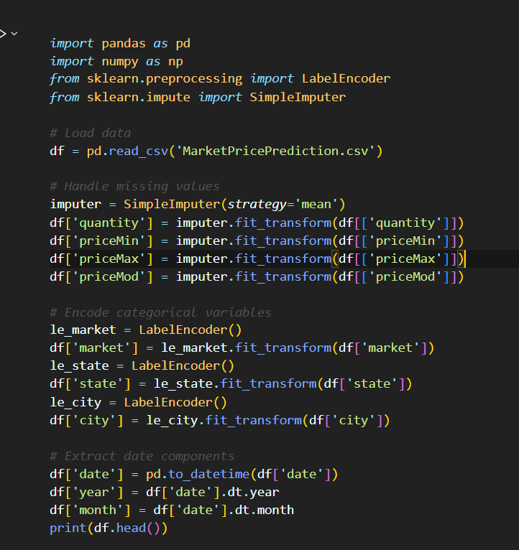
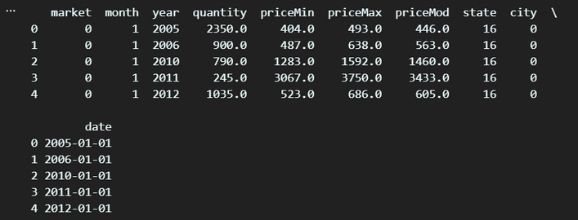
Data Preprocessing

Slide 5
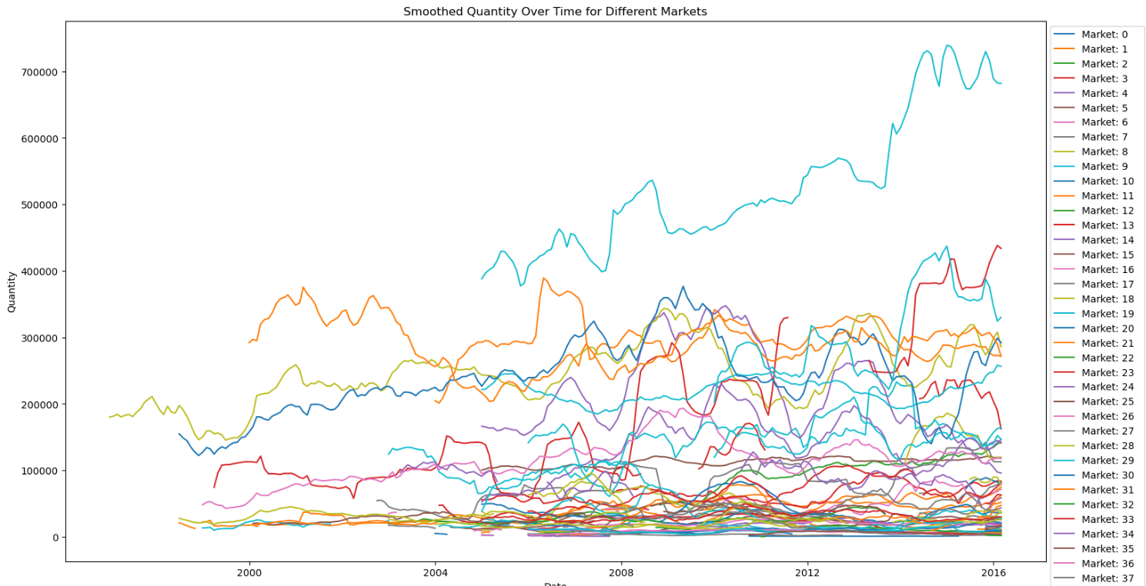
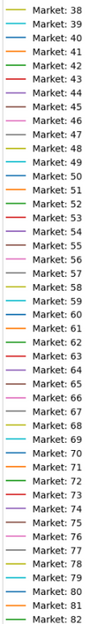
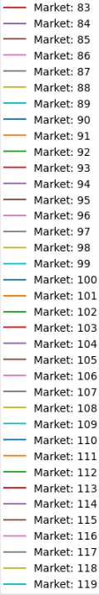
Exploratory Data Analysis

Slide 6
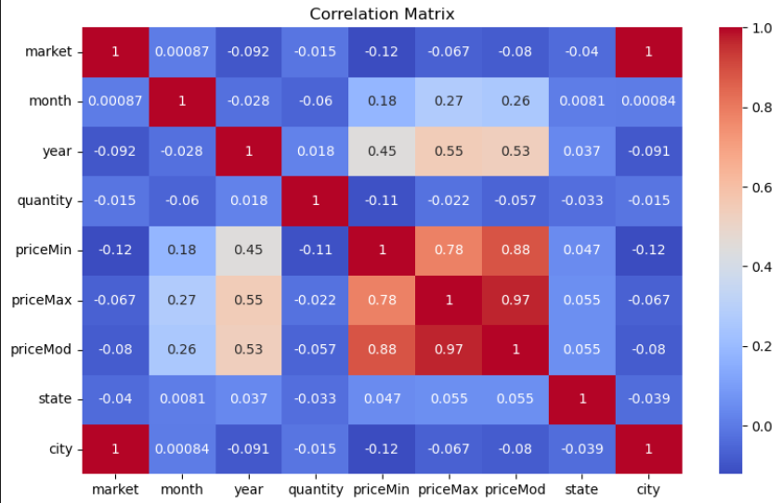
Exploratory Data Analysis

Slide 7
Feature Engineering
Lagged Features
Capture temporal dependencies and autocorrelation.
Create lagged versions of quantity.
Rolling Statistics
Capture local trends and variability.
Create rolling mean and standard deviation features.
Seasonal Indicators
Capture seasonal patterns.
Create dummy variables for months.
Dropping NaNs
Remove rows with NaN values created by shifting operations.

Slide 8
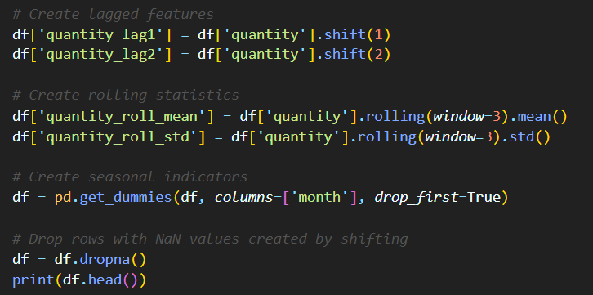
Feature Engineering

Slide 9
Model Selection and Training
Models Chosen for Forecasting
SARIMA (Seasonal Autoregressive Integrated Moving Average)
LSTM (Long Short-Term Memory)

Slide 10

Why SARIMA?
Strengths of SARIMA
Captures Seasonality:
Well-suited for data with strong seasonal patterns.
Incorporates seasonal differencing to handle seasonality directly.
Interpretable Parameters:
Easy to understand and interpret model parameters.
Good for explaining the influence of past values and errors on current values.
Why Chose SARIMA?
Data Characteristics:
The dataset showed evidence of seasonal trends.
SARIMA's ability to handle seasonality made it a suitable choice.

Slide 11

Why LSTM?
Strengths of LSTM
Handles Complex Patterns:
Can capture long-term dependencies and complex temporal patterns.
Suitable for data with non-linear relationships.
Sequential Data Processing:
Designed for sequential data, making it ideal for time series.
Uses memory cells to retain information over time.
Why Chose LSTM?
Advanced Modeling Capability:
LSTM's ability to model complex temporal relationships and non-linearities.
Powerful tool for capturing intricate patterns in the data.

Slide 12
Evaluation Metrics
Metrics Used
Mean Absolute Error (MAE):
Measures the average absolute difference between predicted and actual values.
Mean Squared Error (MSE):
Measures the average squared difference, penalizing larger errors more heavily.
Root Mean Squared Error (RMSE):
Square root of MSE, providing error in the same units as the target variable.

Slide 13
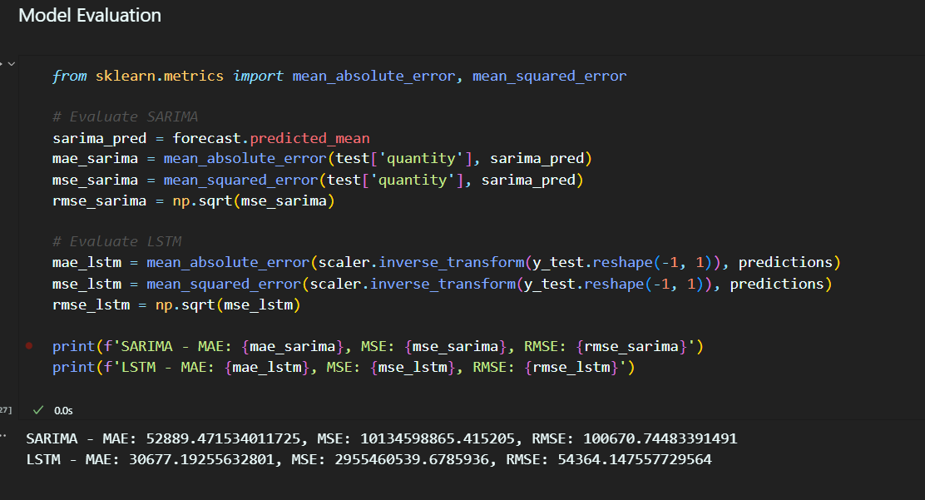
Which Model is Better?

Slide 14
Which Model is Better?
SARIMA Performance
MAE: 52,889.47
MSE: 10,134,598,865.42
RMSE: 100,670.74
LSTM Performance
MAE: 30,677.19
MSE: 2,955,460,539.68
RMSE: 54,364.15

Slide 15
Which Model is Better?
Comparing Performance
Mean Absolute Error (MAE):
LSTM (30,677.19) vs. SARIMA (52,889.47)
Lower MAE for LSTM indicates better average accuracy.
Mean Squared Error (MSE):
LSTM (2,955,460,539.68) vs. SARIMA (10,134,598,865.42)
Lower MSE for LSTM shows fewer large errors.
Root Mean Squared Error (RMSE):
LSTM (54,364.15) vs. SARIMA (100,670.74)
Lower RMSE for LSTM indicates better overall performance.
Conclusion
LSTM is the better performing model based on all three metrics.

